Slide 1
Facial expressions & facial attributes recognition
Deep Learning Class Project
Katerina Daskalopoulou
dit2003dsc@office365.uop.gr

Slide 2
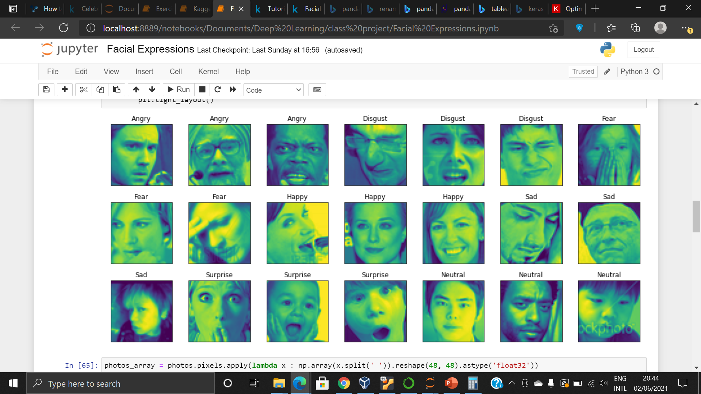
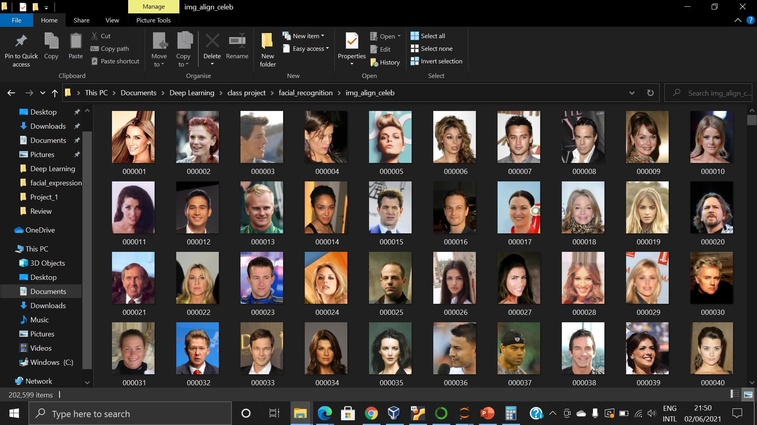
Project objective: experiment on facial expressions & attributes recognition (classification) with cnn
2 Datasets:
Tasks Performed:
A. Facial Expression Recognition
grayscale pictures (48x48)
35.887 instances (csv file)
7 classes (expressions)
Dataset A
1. Multiclass Classification of facial expressions, testing different models & parameters
Dataset B
2. Binary Classification of facial attributes for 4 selected attributes
3. Transfer Learning from model developed on one attribute to predict another
4. Multi-task Model to predict 3 attributes (multi-output)
(using Tensorflow/Keras)
B. Facial Attributes Recognition
coloured pictures (178x218)
202,599 pictures (jpg)
40 binary attribute annotations
Datasets Available at the following links:
https://www.kaggle.com/c/challenges-in-representation-learning-facial-expression-recognition-challenge/data
https://www.kaggle.com/jessicali9530/celeba-dataset

Slide 3
1st task: multiclass classification of “facial expressions”
Classes | #
0: "Angry" | 4.952
1: "Disgust" | 547
2: "Fear" | 5.121
3: "Happy" | 8.989
4: "Sad" | 6.077
5: "Surprise" | 4.002
6:"Neutral" | 6.198
Dataset annotated with 7 “emotions” (single label per image)
Partly imbalanced due to much smaller representation of “Disgust” emotion
3 CNN Model architectures, of Increased Complexity, developed to be tested:
Model 1: 2 (Conv 2D + MaxPooling), 1 Dense, 1 Prediction Layer (very simple-basic)
Model 2: 4 (Conv 2D + MaxPooling), 1 Dense, 1 Prediction Layer
Model 3: 4 ( 2 x Conv 2D + MaxPooling), 2 Dense, 1 Prediction Layer, including Dropout
Link to Notebook in GidHub: Data_Science_Projects/Facial_Expressions_Classification.ipynb at main · katdask/Data_Science_Projects (github.com)

Slide 4
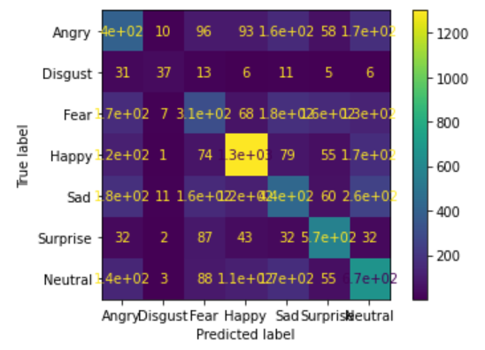
1st task: multiclass classification of “facial expressions”
Test the 3 models with 3 different optimizers (on validation set)
Best combination selected for further hyper-parameters “fine-tuning” (learning rate, batch size)
Model | Optimizers | Acc (%)
Model 1 | A. Optimizer: Adam, lr:0.001 | 52.6
 | B. Optimizer: SGD, lr:0.01 | 49.4
 | C. Optimizer: RMSprop, lr:0.001 | 52.9
Model 2 | A. Optimizer: Adam, lr:0.001 | 55.6
 | B. Optimizer: SGD, lr:0.01 | 48.6
 | C. Optimizer: RMSprop, lr:0.001 | 56.8
Model 3 | A. Optimizer: Adam, lr:0.001 | 62.0
 | B. Optimizer: SGD, lr:0.01 | 60.9
 | C. Optimizer: RMSprop, lr:0.001 | 60.9
Link to Notebook in GidHub: Data_Science_Projects/Facial_Expressions_Classification.ipynb at main · katdask/Data_Science_Projects (github.com)

Slide 5
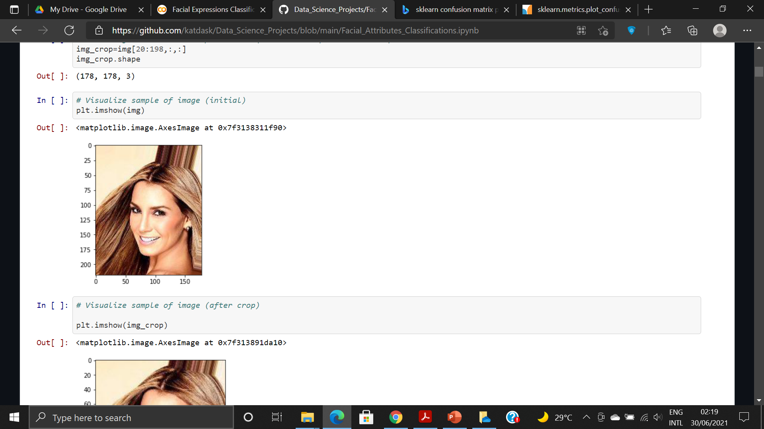
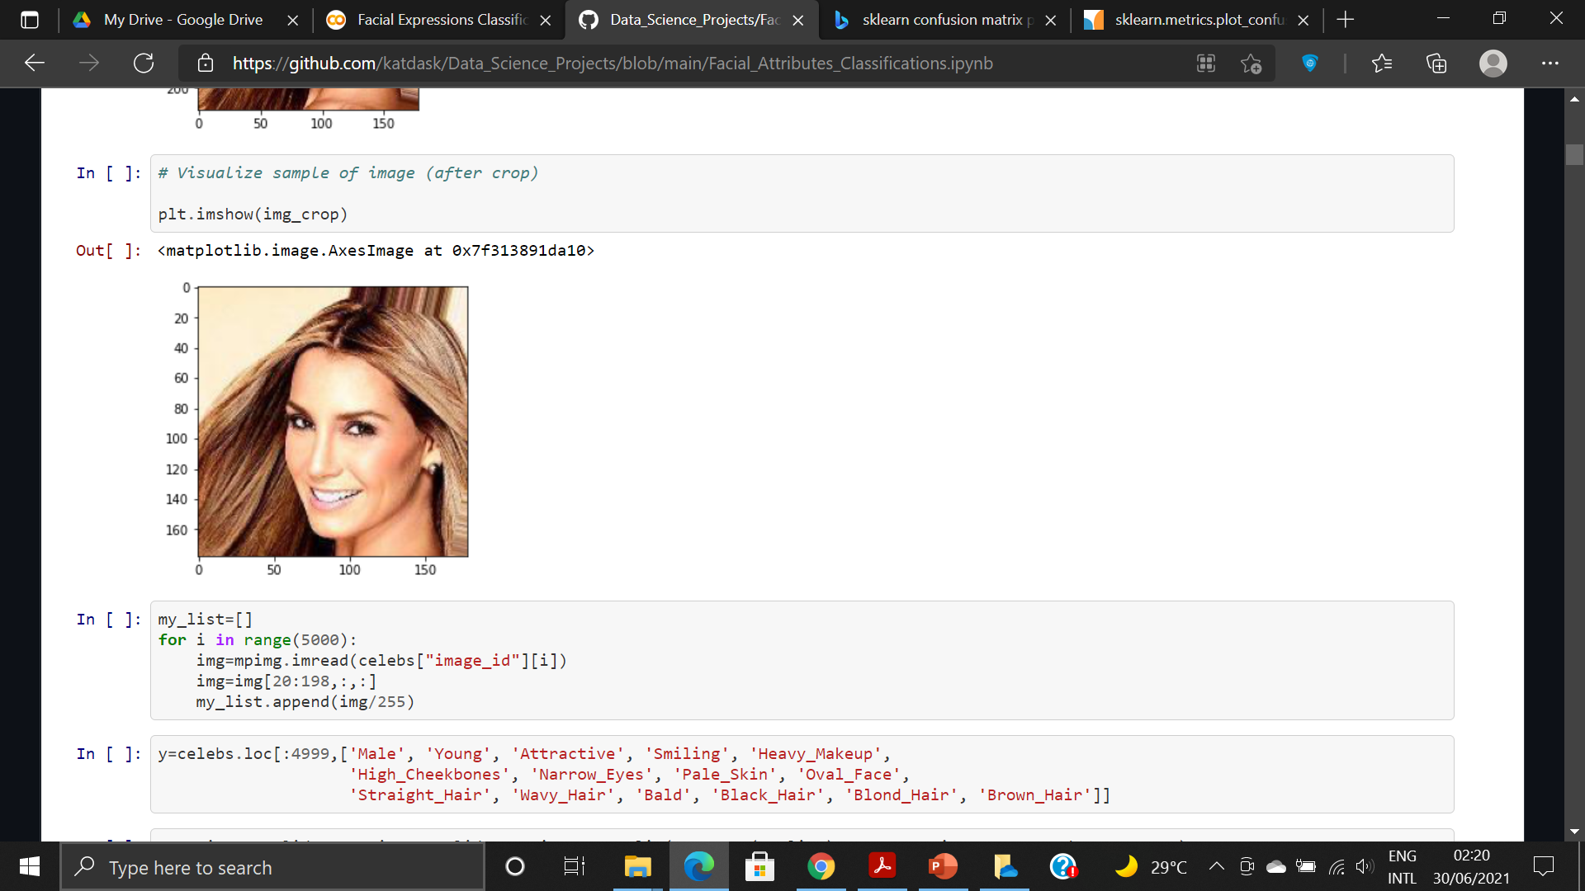
2nd task: binary classification of “facial attributes”
Specific attributes selected from the 40 available for the following tasks
Use only 6.000 instances (4.000 train, 1.000 validation, 1000 test)
178x218 cropped to 178x178
Independent binary classifications with CNNs performed: for the 4 following attributes:
“Male”, “Smiling”, “Young”, “Attractive”
Not very complex CNN Model architectures used:
5 (Conv 2D + MaxPooling), 2 Dense, 1 Prediction Layer
Link to GitHub Notebook: Data_Science_Projects/Facial_Attributes_Classifications.ipynb at main · katdask/Data_Science_Projects (github.com)

Slide 6
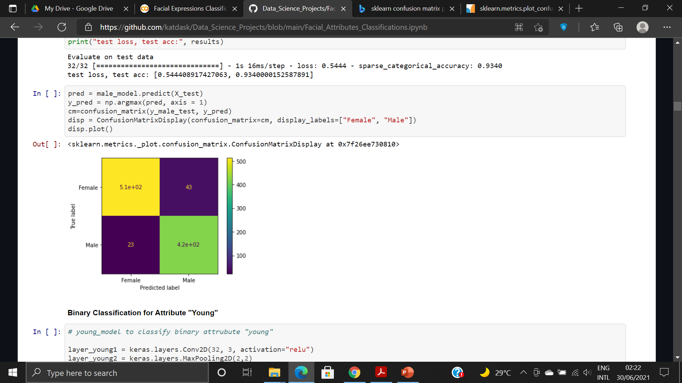
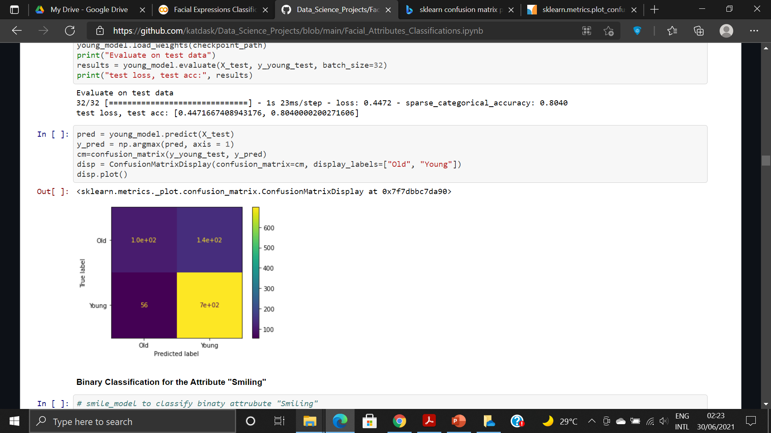
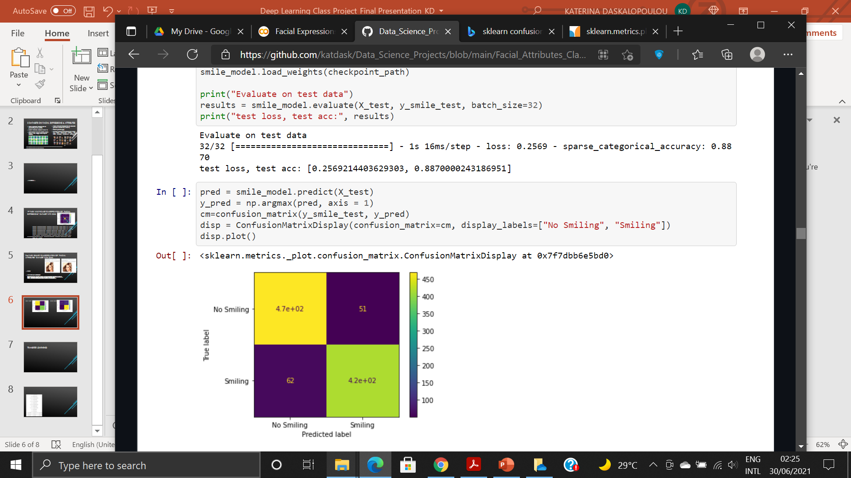
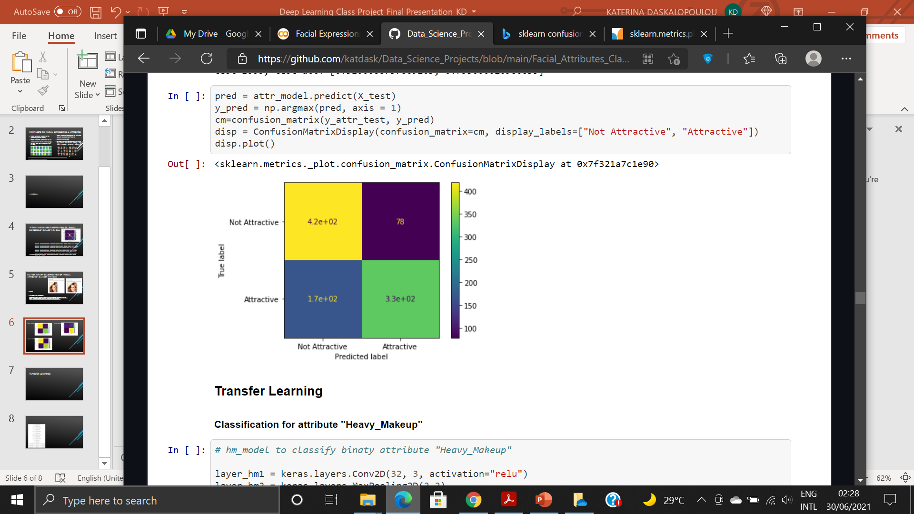
2nd task: binary classification of “facial attributes”
“Male”
Acc: 93.4%
“Young”
Acc: 80.4%
“Smiling”
Acc: 88.7%
“Attractive”
Acc: 75.3%
Link to GitHub Notebook: Data_Science_Projects/Facial_Attributes_Classifications.ipynb at main · katdask/Data_Science_Projects (github.com)

Slide 7
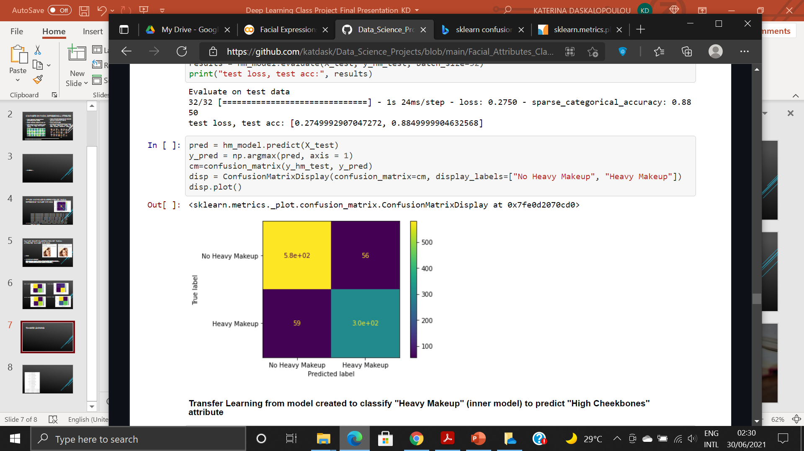
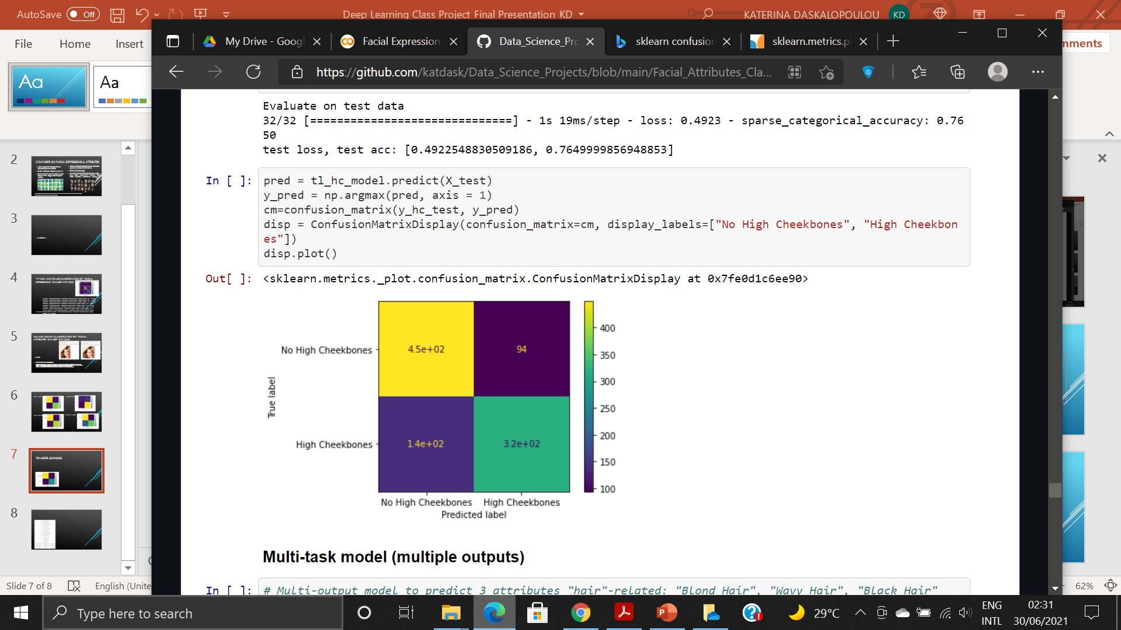
3rd task: TRANSFER LEARNING
Model trained on attribute “Heavy Makeup”
Model consisted of Inner model + final Dense & Prediction layers)
Freeze inner model weights
New model to predict “High Cheekbones” : Inner model (pre-trained) adding Dense & Prediction
“Heavy Makeup”
Acc: 88.5%
“High Cheekbones”
Acc: 76.5%
Link to GitHub Notebook: Data_Science_Projects/Facial_Attributes_Classifications.ipynb at main · katdask/Data_Science_Projects (github.com)

Slide 8
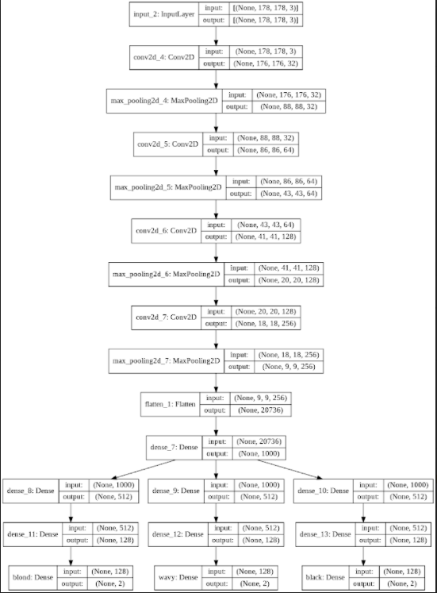
4th task: MULTI-TASK LEARNING
Multi-task Model built & trained to predict 3 attributes “Blond Hair”, “ Wavy Hair” , “Black Hair”
Results:
“Blond Hair” - Acc: 94.6%
“Wavy Hair” - Acc: 75.7%
“Black Hair” - Acc: 85.6%
Link to GitHub Notebook: Data_Science_Projects/Facial_Attributes_Classifications.ipynb at main · katdask/Data_Science_Projects (github.com)

